Slide 1
reCreating the pam250 Matrix
Miriam Bern

Slide 2
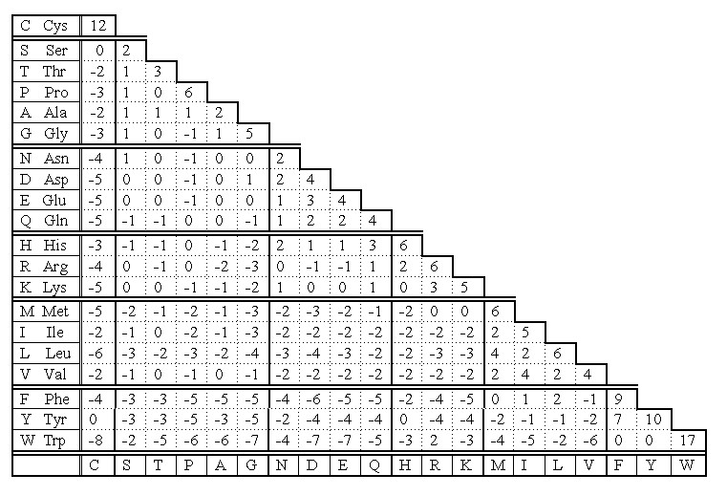
The problem
PAM 250 Matrix used to score sequence alignments
Provides more accurate understanding of which amino acids will be conserved and which mutations will occur
Is it easy to replicate?
Anna’s DNA example:
Why was it not symmetric?

Slide 3
How did I solve it?
Turned steps of Dayhoff paper into Python code
Wrote functions to compute the PAM250 Matrix from the Accepted Point Mutations Matrix
Used the steps to replicate Anna’s DNA example to see what went wrong

Slide 4
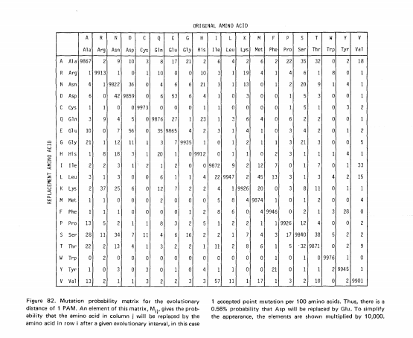
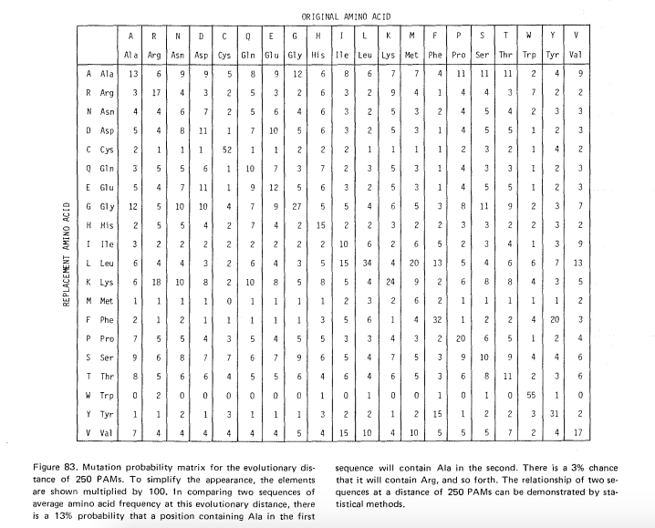
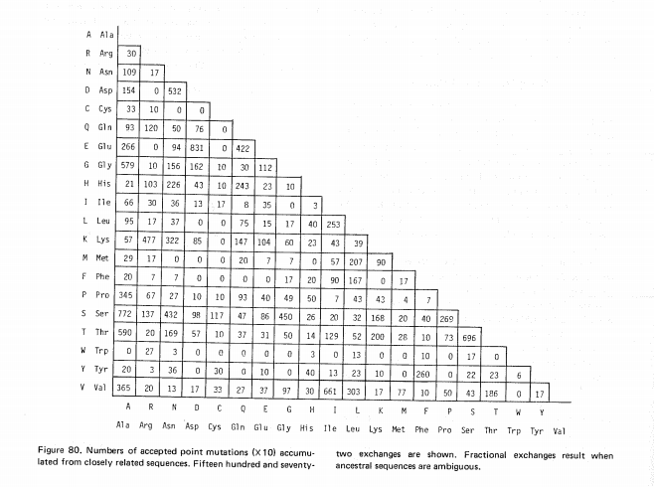
Data
Started out with the Accepted Point Mutations Matrix from the paper as a text file
Made Python dictionaries from the relative mutabilites and frequencies listed in the paper
Used the equations in the paper to construct the matrices
Checked program output against the matrices in the paper

Slide 5
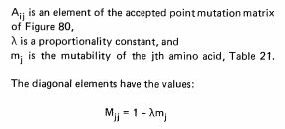


High level steps
Step 1: Calculate proportionality constant (lambda)
Step 2: Using the Accepted Point Mutations Matrix, relative mutabilities, and lambda, create Mutation Probability Matrix for 1 PAM
Step 3: Using Python package NumPy, multiply the matrix by itself 250 times to get the Mutation Probability Matrix for 250 PAMs
Step 4: Divide by the frequency to get the Relatedness Odds Matrix
Step 5: Take the log of these values to get the Log Odds Matrix
Step 6: Reorder the Log Odds Matrix to match the amino acid order in the paper and cut it in half

Slide 6
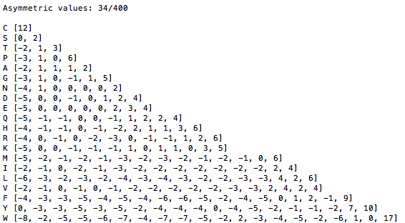
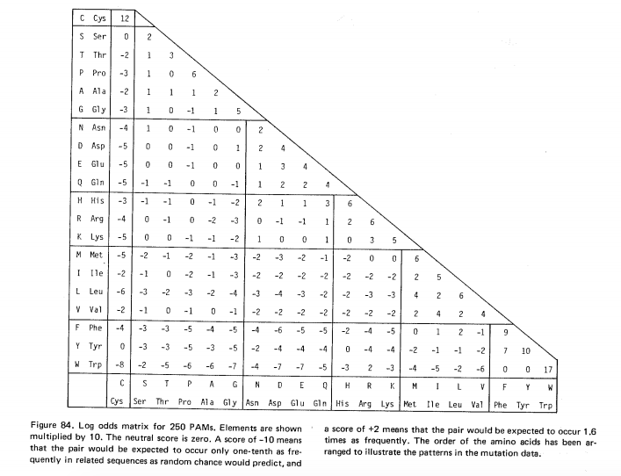
Results: PAM250
I got the same answers! (With a few rounding errors)

Slide 7
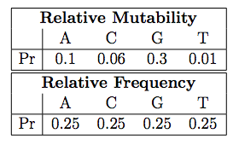
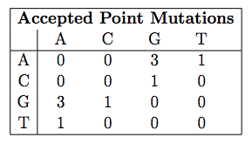
Results: class example
Question: Why was the class example asymmetric?
No proportionality constant used in DNA example
Definitions of frequency and relative mutability make it unlikely that nucleotides with different mutabilities would appear the same number of times

